Slide 1
Software Design Techniques and Mechanisms
Topic: Behavioral Design Patterns
Presenter: Drumea Vasile
Chișinău 2021

Slide 2

Overview
The Behavioral Design Patterns are concerned with the communication between software entities and how it can be realized optimally.
Based on the mechanism used there are 2 types:
Behavioral Class Patterns: Use inheritance to distribute behavior between classes.
Behavioral Object Patterns: Use object composition to have multiple objects perform common tasks.

Slide 3
Chain of Responsibility Pattern
A chain of request handlers that links the sender to the receiver.
The request can be handled partially by all the handlers, or by one specific handler from the chain.

Slide 4
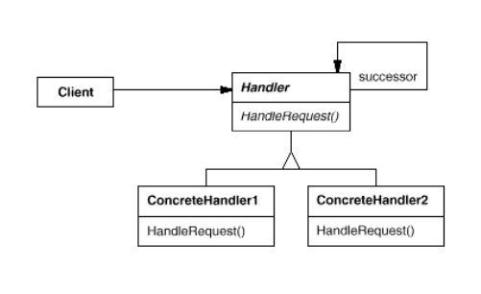
The UML Diagram for Chain of Responsibility

Slide 5
Command Pattern
Encapsulate a request as an object/class so that it can be used whenever it is needed.
The command object provides a blueprint which is a set of method calls for a specific command.
Aka Action, Transaction.

Slide 6
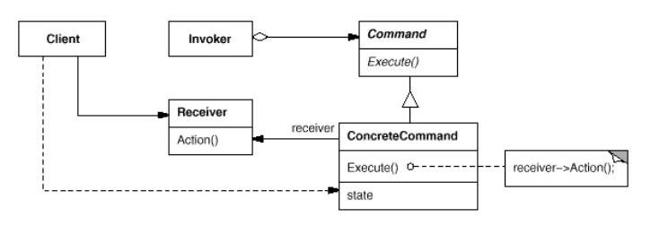
The UML Diagram for Command

Slide 7
Interpreter Pattern
Given a language, define a representation for its grammar along with an interpreter that uses the representation to interpret sentences in the language.

Slide 8
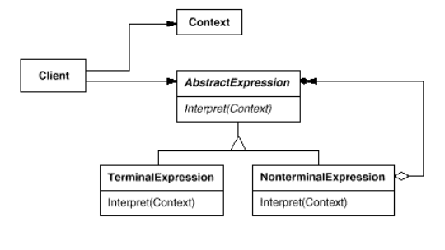
The UML Diagram for Interpreter

Slide 9
Iterator Pattern
Provides a way to access sequentially the elements of an aggregate
object without exposing its underlying representation.
Aka Cursor.

Slide 10
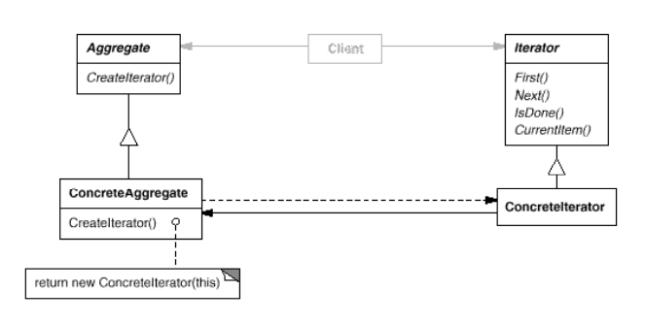
The UML Diagram for Iterator

Slide 11
Mediator Pattern
Define an object that encapsulates how a set of objects interact.
Mediator promotes loose coupling by keeping objects from referring to each other explicitly, and it lets you vary their interaction independently.

Slide 12
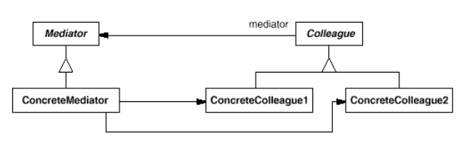
The UML Diagram for Mediator

Slide 13
Observer Pattern
Define a one-to-many dependency between objects so that when one object changes state, all its dependents are notified and updated automatically.
Aka Dependents, Publish-Subscribe.

Slide 14
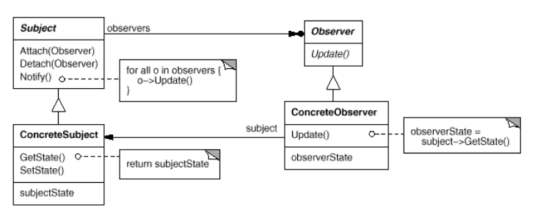
The UML Diagram for Observer

Slide 15
Strategy Pattern
Defines a family of algorithms, encapsulates each one and makes them interchangeable.
Aka Policy.

Slide 16
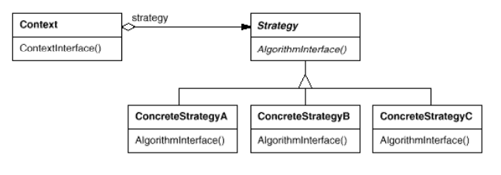
The UML Diagram for Strategy

Slide 17
Visitor Pattern
(Common definition) Represent an operation to be performed on the elements of an object structure. Visitor lets you define a new operation without changing the classes of the elements on which it operates.
Defines an operation to be performed on the elements of a common object structure (inheritance hierarchy/composite object).
The operation is declared in the Visitor class and it will provide (if necessary) multiple implementations for different types of object.

Slide 18
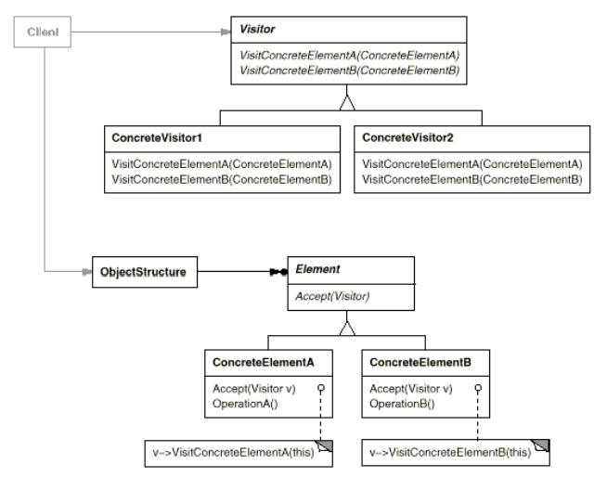
The UML Diagram for Visitor

Slide 19
References
https://sourcemaking.com/design_patterns/behavioral_patterns
The “Gang of four”, 1994, Design Patterns: Elements of Reusable Object-Oriented Software
P.S. All the diagrams are from [2].

Slide 20
Thanks for your attention!
Questions?

